Slide 1

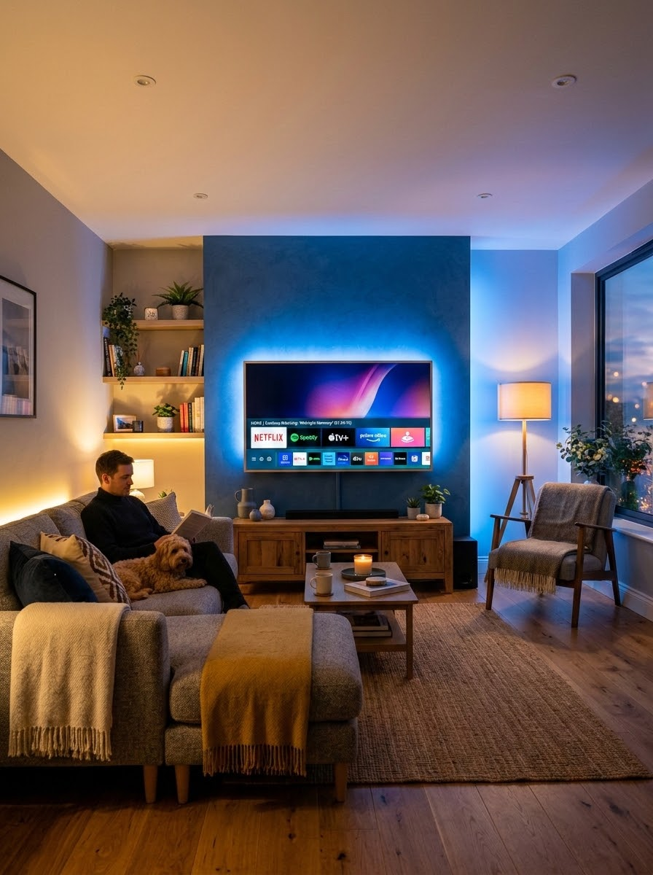
CAMPAIGN PERFORMANCE REVIEW
CAMP DIGITAL PREMIUM STREAMING OPTIMIZATION
Happy Camper Home Services
Premium Streaming (OTT / CTV) Campaign Review
Full Month Performance Report (October 1 – October 31)
Prepared by: CAMP Digital
Platform: Microsoft Advertising Network — Connected TV & Premium OTT
Core Market: Harrisburg-Lancaster-Lebanon-York, PA DMA

Slide 2

The Same Big-Screen Placements as National Brands. Zero Middlemen.
Premium Publisher Access
Full-screen, non-skippable living-room TV ads across Max, Hulu, Disney+, Roku, Paramount+, YouTube TV, Peacock, Samsung TV+, Sling, and Tubi.
Zip-Code & DMA Precision
Hyper-local targeting ensures your ads only air inside your active plumbing, HVAC, or electrical service footprint.
Unbiased Platform Access
Agnostic placement across both Microsoft Advertising and Google Ads networks — we optimize for your results, not platform commissions.

Slide 3
INVENTORY ACCESS
The Same Big-Screen Placements as National Brands
Direct access to premium streaming inventory — full-screen, non-skippable, sound-on advertising delivered on television screens inside premium content environments.
YouTube Select
Hulu
Disney+
Max
Hyper-local by design
Delivery is confined to your active service footprint — down to specific cities and ZIP codes, not the whole DMA.
Paramount+
Peacock
Roku Channel
Samsung TV Plus
Unbiased placement
Options across both the Microsoft and Google networks, chosen on performance rather than on which inventory we happen to resell.
Pluto TV
Tubi
ESPN
Prime Video
Television-grade recall
Full-screen, sound-on exposure on the household TV builds significantly stronger recall than mobile advertising alone.
BOUGHT DIRECT, NOT RESOLD
Every environment above is purchased through the Microsoft or Google engines at publisher cost — the same inventory national advertisers buy, without a reseller standing between Lowry Home Services and the impression.
CAMP Digital · Premium Streaming Media Plan · Lowry Home Services · September 2026
5

Slide 4
Building Brand Demand to Lower Your PPC Cost-Per-Lead.
CTV Awareness
(top-of-mind brand trust on living room screens)
Search & TV Working Together
CTV creates top-of-mind trust. Search PPC captures the appointment when the repair is needed. Together, they compound your results.
Cross-Channel Retargeting
• Microsoft IMBR: Retarget TV viewers with follow-up Search, Native, or Display ads
• Google Demand Gen: Re-engage warm streaming audiences across YouTube Shorts, Gmail, and Discover
Lower CPL and Higher PPC Conversion Rates
(higher CTR, lower acquisition cost)
Branded Searches
(homeowners search your name directly)

Slide 5

CAMPAIGN STATUS
Premium Streaming Pilot: Establishing the Local Baseline
Our October campaign successfully positioned Happy Camper Home Services as the dominant local plumbing brand on big-screen TVs across the Harrisburg-Lancaster-Lebanon-York DMA.
TOTAL BUDGET INVESTED
TOTAL AD IMPRESSIONS
$10,000.00
1,127,322
100% budget utilization; $19.26 overspend credited back
Exceeded 1.1M video views
BLENDED CAMPAIGN CPM
CORE DMA DELIVERY
$8.89
98.6%
vs. $20.00–$40.00 industry average
Harrisburg-Lancaster-Lebanon-York DMA
KEY STRATEGIC TAKEAWAY
October achieved our primary objective of establishing a high-volume, cost-efficient local streaming baseline, securing over 1.1 million views at an efficient $8.89 CPM, demonstrating local saturation while preserving budget room to bid up for higher-tier premium placements in August.

Slide 6

MARKETPLACE STANDARDS
Beating Industry & Marketplace Standards
By leveraging CAMP Digital’s premium programmatic bidding strategies, Happy Camper Home Services achieved a significantly lower CPM than national and network benchmarks.
COST EFFICIENCY
Delivered 56%–78% more impressions per dollar than standard marketplace resellers.
Market Benchmark | Avg CTV CPM | Happy Camper Advantage
Traditional Industry Avg | $20.00 to $40.00 | 56% to 78% Lower
Happy Camper Home Services (October Final) | $8.89 | Baseline Established ✓
STRATEGIC IMPLICATION
Operating below benchmark proves our targeting is clean and gives us the exact leverage needed to increase bids in August for premium Tier-1 inventory without blowing out the budget.
KEY PERFORMANCE TAKEAWAY
Operating significantly below marketplace benchmarks validates CAMP Digital's premium CTV approach. This cost efficiency establishes a highly optimized baseline, securing the strategic budget flexibility required to aggressively capture premium Tier-1 inventory in August without risk of overspending.

Slide 7
AUDIENCE TARGETING
Pinpoint Accuracy: Reaching Mature Local Homeowners
Demographic targeting successfully locked in on active, mature homeowners who own property and require plumbing services.
99.9%
25+ Prime Homeowners
Targeted impressions successfully reached adults 25+; the 18–24 demographic was explicitly excluded.
REACH & FREQUENCY MODEL
EST. UNIQUE REACH
~128K
Unique Devices
Represents approximately 80K Households across target areas
AVG. AD FREQUENCY
8.8x
Per Unique Device/Month
The optimal frequency sweet spot to establish maximum local brand recall.
92.1%
35+ Age Concentration
863,615 impressions reached active, mature adults aged 35 and older.
16.8%
Unknown Category (CTV Privacy)
189,681 impressions fell into privacy-protected unknown buckets, typical for CTV household identity graphs.
STRATEGIC VALUE
A 8.8x frequency is a starting point for brand recall—ensuring when a pipe bursts or a water heater fails, Happy Camper Home Services is top-of-mind. Projections modeled from identity-matched CTV sample data (38.3k impressions) across 1.12M total delivered campaign impressions.

Slide 8
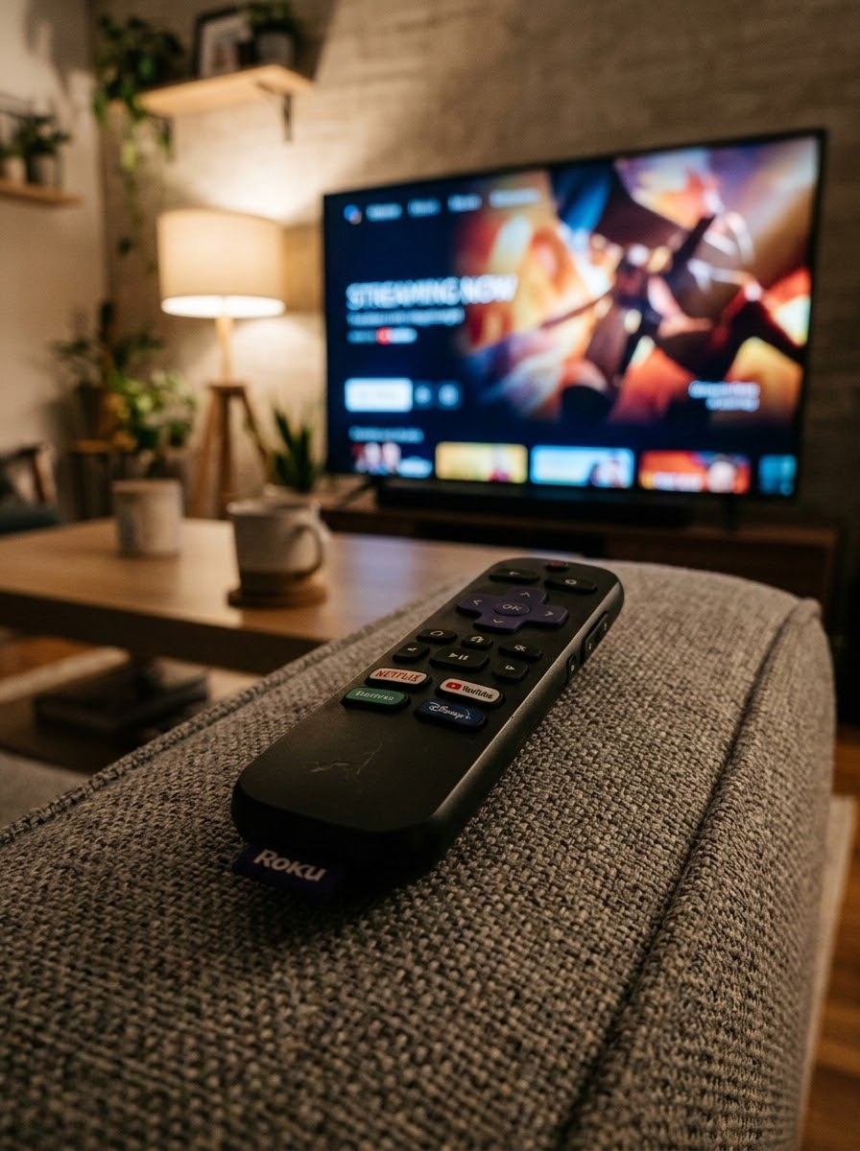
DEVICE BREAKDOWN
Prioritizing High-Impact Sight, Sound, and Motion
Streaming ads delivered almost exclusively on Connected TVs in the living room, ensuring maximum brand recall and household engagement.
📺 Connected TV (CTV)
Spend: $9,284.71 | 92.7% share
1,054,439 impressions (93.5% Share) at $8.80 CTV CPM
High-definition, unskippable ads delivered directly on home television screens.
🖥️ Desktop & Computers
Spend: $473.29 | 4.7% share
72,380 impressions at $6.54 CPM
Secondary cross-device touchpoints across local computer screens.
📱 Smartphones & Tablets
Spend: $261.26 | 2.6% share
503 impressions — CPM: N/A
Kept minimal by design to avoid small-screen ad fatigue and wasteful clicks.

Slide 9
NETWORK PERFORMANCE
High-Quality Local Broadcast Partnerships
Ads aired across premium, family-friendly streaming platforms and living room apps.
Volume Leader
Sling TV generated 345,912 impressions at an ultra-efficient $6.21 CPM.
Big Screen Scale
Roku and Samsung TV Plus combined for $4,240.74 (42% of budget), driving massive living room penetration.
Platform
Spend
Impressions
Avg CPM
VCR
Roku Ecosystem
$2,239.83
233,700
$9.58
99.0%
Sling TV Ecosystem
$2,148.02
345,912
$6.21
98.4%
Samsung TV Plus
$2,000.91
200,731
$9.97
98.3%
Paramount+
$679.66
50,523
$13.45
98.6%
Vizio WatchFree
$660.55
47,622
$13.87
99.3%
Hulu Plus Roku TV (com.hulu.plus.roku)
$562.48
40,666
$13.83
99.5%
Tubi TV Ecosystem
$202.89
21,341
$9.51
99.1%
Best CPM
Most Impressions
Largest Spend
Sling TV Ecosystem at $6.21
Sling TV Ecosystem: 345,912
Roku Ecosystem: $2,239.83

Slide 10
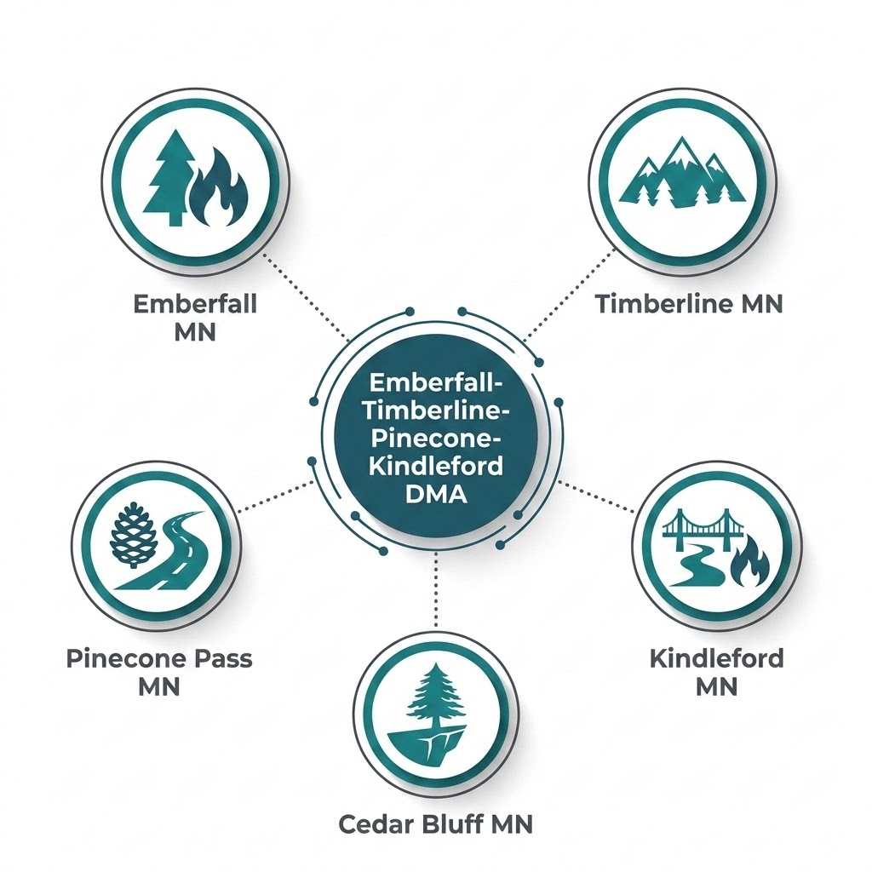
GEOGRAPHIC TARGETING
Saturating the Core Service Area
By enforcing strict geographical boundaries, 98.6% of campaign dollars remained directly inside Happy Camper Home Services’ core market territory.
Emberfall-Timberline-Pinecone-Kindleford, MN
Impressions: 1,112,365 (98.7% of total) | Spend: $9,874.28 @ $8.88 CPM
CITY
SPEND
IMPRESSIONS
CPM
Emberfall, MN
$1,454.00
155,000
$9.38
Timberline, MN
$1,217.00
146,000
$8.34
Pinecone Pass, MN
$1,115.00
128,000
$8.71
Kindleford, MN
$447.00
51,000
$8.76
Cedar Bluff, MN
$441.00
47,000
$9.38
Zero Budget Waste
0% spent outside the service area
Homeowner Focus
Core local demographic saturation
High Frequency
Repeated exposure across local households

Slide 11

AUDIENCE STRATEGY
Balancing Mass Market Awareness with Warm Lead Conversion
IN-MARKET AUDIENCE
SITE REMARKETING POOL
$8.55
$19.73
Highly efficient CPM
Precise target CPM
Drives bulk reach. Home & Garden segment scales broad funnel awareness cost-effectively across active local households.
Captures warm prospects and stays top-of-mind with past site visitors, building trust and accelerating conversion.
KEY TAKEAWAY
The campaign utilized a two-tiered targeting strategy to capture top-of-funnel homeowner awareness while remarketing to recent website traffic.

Slide 12
KEY TAKEAWAYS
Key Takeaways & Next Steps
October Wins
$8.90 CTV CPM, 40% to 64% below industry average
1.13M impressions with 97.96% video completion rate
92.1% of delivery reached homeowners 35+
98.6% of spend inside core DMA territory
About 128K unique households reached at 8.8x frequency
August Priorities
Raise CPCV bids to $0.05 to $0.08 for Tier-1 access
Target more premium inventory with higher bids
Enforce 100% CTV big-screen delivery, no desktop remnants
Activate Microsoft Curated Package Beta for local home services
Maintain $322/day even pacing on $10,000 August budget
Maintain a frequency between 6–10 for remainder of month
THE BOTTOM LINE
October's results established a strong baseline. August builds on that foundation by trading CPM headroom for better placements and deeper household reach.

Slide 13
CAMPAIGN PROPOSAL
CAMP DIGITAL PREMIUM STREAMING OPTIMIZATION
Lowry Home Services
Premium Streaming (OTT / CTV) Campaign Review
Full Month Performance Report (Sept 1 – Sept 30)
Prepared by: CAMP Digital
Platform: Microsoft Advertising Network — Connected TV & Premium OTT
Core Market: Denver

Slide 14
PRICING MODEL
100% Working Media. Zero Hidden Tech Taxes.
Media is purchased directly through the ad engines at transparent CPM-based pricing, with a flat monthly management fee that keeps our incentives aligned with campaign outcomes.
TRADITIONAL CTV MODELS
—Hidden platform markups and unknown inventory fees
—Layered reseller margins that shrink working media
—Obscured placement and performance reporting
THE CAMP DIGITAL MODEL
✓100% of media budget goes to buying impressions
✓Flat monthly management fee, disclosed up front
✓Direct access to placement, CPM and delivery reporting
LOWRY'S MONTHLY MEDIA
$10,000
NET USD, working media
THIRD-PARTY MARKUPS
$0
No reseller margin in the buy
ESTIMATED IMPRESSIONS
733,000
Across two targeted ad groups
CAMP Digital · Premium Streaming Media Plan · Lowry Services · October 2026
6

Slide 15
GEOGRAPHIC TARGETING
35 Communities. Zero Wasted Impressions.
Delivery is confined to the suburban Philadelphia communities Lowry actively services — Montgomery, Bucks, Chester and Delaware county towns bought by name rather than by DMA.
Gladwyne
Bryn Mawr
Haverford
Bala Cynwyd
Blue Bell
COMMUNITIES TARGETED
35
Named city-level geo targets
Villanova
Doylestown
Newtown
New Hope
Fort Washington
Gwynedd Valley
Chester Springs
Malvern
Paoli
Devon
DEVICE SCOPE
42+ inch TV Screens
CTV-led, cross-screen
King of Prussia
Ambler
Harleysville
Collegeville
Phoenixville
Lansdale
Montgomeryville
Chalfont
Richboro
Yardley
Washington Crossing
Kennett Square
Glen Mills
Media
West Chester
FLIGHT LENGTH
30 Days
October 2026
Conshohocken
Plymouth Meeting
Lafayette Hill
Spring House
Dresher
WHY THIS MATTERS
A Philadelphia DMA broadcast buy would put roughly nine in ten impressions in front of households Lowry cannot profitably serve. City-level CTV targeting spends the same dollars only where the trucks already run.
CAMP Digital · Premium Streaming Media Plan · Lowry Services · October 2026
12

Slide 16
THE PROPOSAL
The Lowry Services Premium Streaming Plan
One campaign, two ad groups, each with individual targeting — built to create demand at the top of the funnel and recapture it at the bottom.
NETWORK
Microsoft Audience Network
PLACEMENT
CTV / OTT
AD UNITS
:05 – :90
FLIGHT
30 days
DEVICE
Cross Device
PRICING
CPCV · $0.02 est. bid
Ad group
Targeting
Est. impressions
Monthly investment
Implied CPM
In-Market — Relevant Audiences
Home & Garden in-market audience
550,000
$8,000
$14.55
Retargeting — All Visitors
Remarketing list — all site visitors
183,000*
$2,000
$10.93
Total
1 campaign / 2 ad groups
733,000
$10,000
$13.64
READ THIS ALONGSIDE THE GEOGRAPHY
550,000 in-market impressions build the brand across 35 communities; 183,000 retargeting impressions keep Lowry in front of households that have already visited the site. Every dollar of the $10,000 is working media.
*Retargeting impressions estimated at an average frequency of 3. All impressions are estimates and are not guaranteed; pricing is dynamic based on market demand. All dollars are NET USD. Implied CPM is derived from monthly investment ÷ estimated impressions.
CAMP Digital · Premium Streaming Media Plan · Lowry Services · October 2026
13
Notes:
Source: Lowry Services - Media Plan worksheet. In-market line: 550,000 impressions / $8,000. Retargeting line: 183,000 impressions / $2,000, based on an average frequency of 3. Total $10,000 NET. Implied CPMs derived, not quoted in the workbook.

Slide 17
INCLUDED AT NO ADDITIONAL COST
Two Assets Lowry Keeps Beyond the Impressions
The plan includes added-value components that most CTV vendors either charge for or simply do not offer.
ADDED VALUE 01
Impression-Based Remarketing
Every household exposed to Lowry's streaming ad is assembled into a remarketing list — usable across Search, Performance Max, Display, Native and Online Video.
ADDED VALUE 02
Ad Effectiveness Study
Formal measurement of search lift, impact on the consumer decision journey and multi-touch attribution, correlated to Microsoft Audience Network ad exposure.
The audience built by the TV campaign becomes a targeting asset for every other channel Lowry runs.
Requires approximately 1.5M impressions within a 30-day period to run.
THE SCALE PATH
Unlocking the brand lift study
The October plan delivers an estimated 733,000 impressions. The study requires roughly 1.5M in a 30-day window, so it becomes available as the program scales — worth revisiting once the first flight establishes a delivery and completion baseline.
OCTOBER PLAN
733K
STUDY THRESHOLD
1.5M
CAMP Digital · Premium Streaming Media Plan · Lowry Services · October 2026
15

Slide 18

THE RECOMMENDATION
What Lowry Services Receives for $10,000 a Month
✓733,000 estimated premium CTV/OTT impressions over a 30-day flight
✓Delivery confined to 35 named suburban Philadelphia communities
✓In-market Home & Garden targeting plus all-visitor retargeting
✓Direct-to-engine buying — no reseller markup on any impression
✓Impression-Based Remarketing audience, included at no extra cost
✓App-level placement, CPM and completion reporting every month
MONTHLY INVESTMENT
$10,000
NET USD · 100% working media · fully scalable
NEXT STEP
Complimentary local CTV audit
A real-time inventory forecast across Lowry's 35 communities, confirming the streaming audience supports a sustained television presence — before a dollar is committed.
CAMP
DIGITAL
Ready to own the big screen in your service territory?
Request Your Free CTV Audit
All impressions are estimates and are not guaranteed. Pricing is dynamic based on market demand. All dollars are NET USD.

